Slide 1
God’s plan in the heavens
John Ensworth

Slide 2
God’s Plan in the Heavens
We’re going to explore some possible astronomical/spiritual depths to:
Psalm 19:1-2 The heavens declare the glory of God; the skies proclaim the work of his hands. Day after day they pour forth speech; night after night they reveal knowledge.
Notes:
Psalm 19:1-6 ¹ The heavens declare the glory of God; the skies proclaim the work of his hands. ² Day after day they pour forth speech; night after night they reveal knowledge. ³ They have no speech, they use no words; no sound is heard from them. ⁴ Yet their voice^{[b]} goes out into all the earth, their words to the ends of the world. In the heavens God has pitched a tent for the sun. ⁵ It is like a bridegroom coming out of his chamber, like a champion rejoicing to run his course. ⁶ It rises at one end of the heavens and makes its circuit to the other; nothing is deprived of its warmth.

Slide 3
God’s Plan in the Heavens
The Gospel In the Stars?
Astrology may be a twist on the Good News God placed in the heavens to foretell of the coming of Jesus and the Truth of the Gospel.

Slide 4
God’s Plan in the Heavens
The truth of Astrology?
God placed the meanings of the patterns stars of the zodiac on men’s hearts and a desire to tell what was to come – salvation available to all mankind.
(Also for the Heb 11’s “Hall of Faith?”)

Slide 5
God’s Plan in the Heavens
From: Jeremiah 31:35-37
“This is the covenant I will make with the people of Israel after that time,” declares the LORD. “I will put my law in their minds and write it on their hearts. I will be their God, and they will be my people. ³⁴ No longer will they teach their neighbor, or say to one another, ‘Know the LORD,’ because they will all know me, from the least of them to the greatest,” declares the LORD. “For I will forgive their wickedness and will remember their sins no more.”
Notes:
also Ecclesiastes 3:11 ¹¹ He has made everything beautiful in its time. He has also set eternity in the human heart; yet no one can fathom what God has done from beginning to end.

Slide 6
God’s Plan in the Heavens
Jeremiah 31:35-37
³⁵ This is what the LORD says, he who appoints the sun to shine by day, who decrees the moon and stars to shine by night, who stirs up the sea so that its waves roar— the LORD Almighty is his name: ³⁶ “Only if these decrees vanish from my sight,” declares the LORD, “will Israel ever cease being a nation before me.”
Notes:
also Ecclesiastes 3:11 ¹¹ He has made everything beautiful in its time. He has also set eternity in the human heart; yet no one can fathom what God has done from beginning to end.

Slide 7
God’s Plan in the Heavens
Jeremiah 31:35-37
³⁷ This is what the LORD says: “Only if the heavens above can be measured and the foundations of the earth below be searched out will I reject all the descendants of Israel because of all they have done,” declares the LORD.
Notes:
also Ecclesiastes 3:11 ¹¹ He has made everything beautiful in its time. He has also set eternity in the human heart; yet no one can fathom what God has done from beginning to end.

Slide 8
God’s Plan in the Heavens
Similar to: Romans 2:14-15
Indeed, when Gentiles, who do not have the law, do by nature things required by the law, they are a law for themselves, even though they do not have the law. They show that the requirements of the law are written on their hearts, their consciences also bearing witness, and their thoughts sometimes accusing them and at other times even defending them.
Notes:
also Ecclesiastes 3:11 ¹¹ He has made everything beautiful in its time. He has also set eternity in the human heart; yet no one can fathom what God has done from beginning to end.

Slide 9
God’s Plan in the Heavens
Similar to: Hebrews 8:10
This is the covenant I will establish with the people of Israel after that time, declares the Lord. I will put my laws in their minds and write them on their hearts. I will be their God, and they will be my people.
Notes:
also Ecclesiastes 3:11 ¹¹ He has made everything beautiful in its time. He has also set eternity in the human heart; yet no one can fathom what God has done from beginning to end.

Slide 10
God’s Plan in the Heavens
What is Astrology?
The belief that the position of the sun, moon and planets in the stars tell of what is to come somehow.
Notes:
Personality from birth, or the outcome of an upcoming battle/war, or when is best to invest, etc.

Slide 11
God’s Plan in the Heavens
What is Astrology? (Zodiac = Mazzeroth)
Job 38:32 (Amplified Bible)
³²Can you lead forth the signs of the zodiac in their season? Or can you guide [the stars of] the Bear with her young?
Job 38:32 (New International Version) ³² Can you bring forth the constellations in their seasons or lead out the Bear^{[b]} with its cubs?
Notes:
Personality from birth, or the outcome of an upcoming battle/war, or when is best to invest, etc.

Slide 12
God’s Plan in the Heavens
What are these?
Constellations
Conjunction
Zodiac
Ecliptic
Vernal Equinox

Slide 13
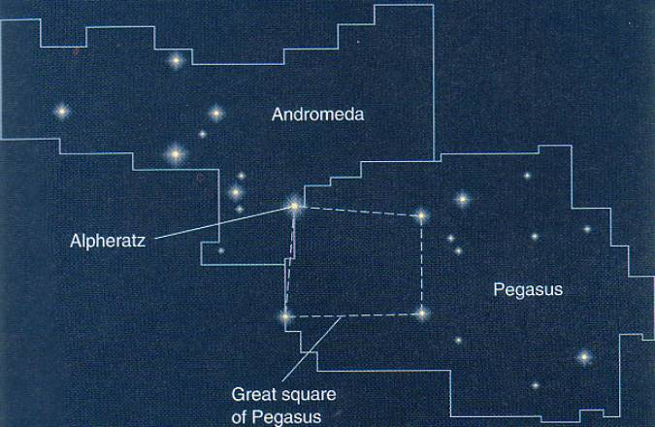
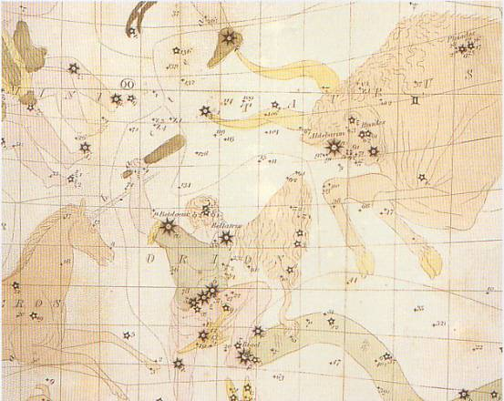
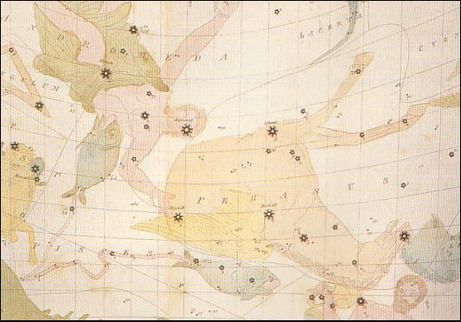
God’s Plan in the Heavens
Constellations
Notes:
88 constellations in all – all people’s have made their own pictures across the sky out of the stars (no street lights or flat screen TV’s in people’s homes for 1000’s of years.

Slide 14
God’s Plan in the Heavens
A conjunction is just when two or more things in the sky get really close to one another.
How close is not really defined.
Notes:
88 constellations in all – all people’s have made their own pictures across the sky out of the stars (no street lights or flat screen TV’s in people’s homes for 1000’s of years.

Slide 15
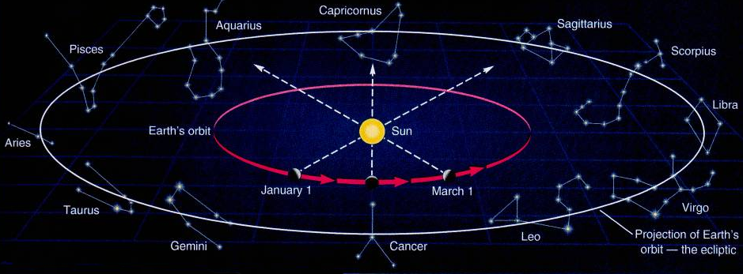
God’s Plan in the Heavens
The Zodiac
Notes:
Means Circle of Animals – for the common use of astrology today – it is the constellation the sun appears to be covering when you are born (footnote: precession, the 26,500 year wobble of the Earth’s axis messed this up 1000’s of years ago.)

Slide 16
God’s Plan in the Heavens
The Ecliptic – the Path of the Sun, Moon and Planets through the stars
Notes:
The ecliptic is tilted due to the tilt of the Earth’s axis – which gives us Seasons and the Vernal Equinox…. next slide.

Slide 17
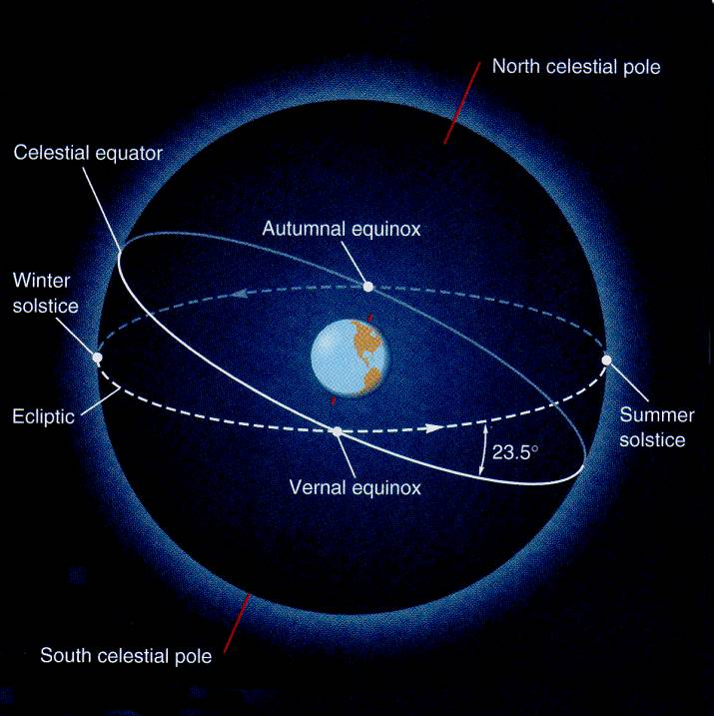
God’s Plan in the Heavens
Notes:
The first day of Spring, the sun is located on the Vernal Equinox (since the Earth is tilted on it’s axis – or the sun moon and planets would go around the equator all the time – and we’d have no seasons).

Slide 18
God’s Plan in the Heavens
What we expect is that multiple peoples would have similar figures in these constellations.
That is what we’ll now look at…

Slide 19
God’s Plan in the Heavens
The first four constellations tell of:
The Nature of Christ
His Work
His Triumph over Satan/Sin/Death

Slide 20
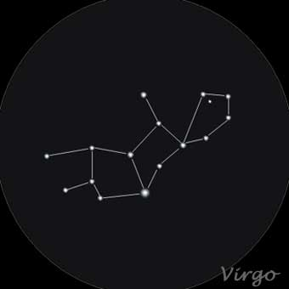
God’s Plan in the Heavens
Virgo – The Virgin – Virgin Mary
Egypt- Isis (helped create the Milky Way)
Chaldean Ishtar, “Queen of Stars”
One of Solomon’s wives
India – mother of the great god Drishna
Greek – Persephone, daughter of Zeus and Demeter (Ceres), goddess of the harvest
The Birth of Christ.

Slide 21
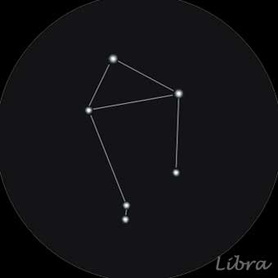
God’s Plan in the Heavens
Libra– The Scales
The balance of justice in human affairs as well as the balanced arrangement of Nature’s laws
Egyptian in origin probably -
Hebraic = Moznayim or “Scales” the “Balance” in which Belshazzar, Nebuchadnezzar’s son was ‘weighed’ and ‘found wanting’ (Dan 5:27)
The false gospel of the gospel of good works vs. bad works.
Notes:
[The choice between a life of works (good out weighing evil) or a life by grace – a gift of freedom given by God through Jesus. Sin must be paid for somehow.]

Slide 22
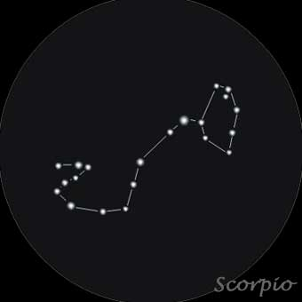
God’s Plan in the Heavens
Scorpius – The Scorpion
The Birthplace of Mars (Antares = rival of Mars or similar to Mars)
Regarded as the source of storms
Originated as far back as 5,000 B.C. by Euphratean astronomers
Israelites ‘Akrabh’ = the Scorpion , also in Egypt, Mayans, Greek, Persia, Turkey, India
The Deadly Foe – Satan or his sting (death). The foe Jesus defeated.

Slide 23
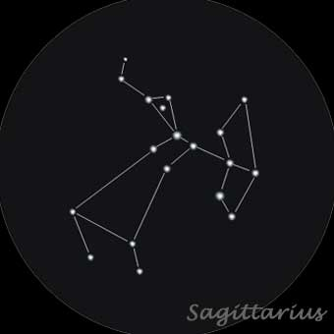
God’s Plan in the Heavens
Sagittarius – Man/Horse Archer
Half man and half horse- an archer. (A Centaur)
Euphrateans – the Archer Nergal , the god of war
India – a Horse’s head with a fan of lions tails
Dual nature – a Christ picture – firing an arrow into the heart of death.

Slide 24
God’s Plan in the Heavens
The second four constellations tell of:
The Fruits of Christ’s Finished Work.
His position as our mediator.
The relationship between Christ and his Church.

Slide 25
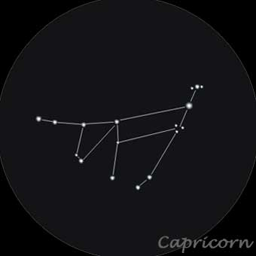
God’s Plan in the Heavens
Capricornus– Goat/Fish
Bacchus’s goat disguise as he dove into the Nile river to hide from a marauding monster – he got a fish tail for swimming.
Ancient Chinese was and Ox, then became a Goat-Fish.
Egyptian water god bearing a goat’s horns
A Goat by the Persians, Turks, Syrians and Arabians
Water = The Holy Spirit
Another dual nature picture (Jesus)- The sacrificial lamb that Jesus was for all time and His Holy Spirit.

Slide 26
God’s Plan in the Heavens
Aquarius– The Water Bearer
Arabians – a mule carrying two water buckets, or just a water bucket
Egyptians – Monius (derived from muau or ‘water’)
A water bucket to the Persians, Israelites, Syrians, and the Turks.
A Chinese emperor Tchoun Hin, who reigned during a great flood named it for the flood-
Noah’s Flood is associated with this constellation as is a great flood sent by Zeus.
The source of living water. His Holy Spirit. Also Noah’s Flood- cleansing and world destruction by that account.

Slide 27
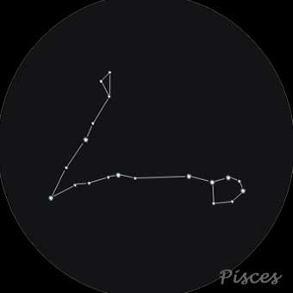
God’s Plan in the Heavens
Pisces– The Fish
Another disguise for a Greek god – two fishes that swam away in the Nile.
“Leaders of the Celestial Host” due to the location of the V.E.
Hebrew “Two Fishes”
It was also significant to the early Christians and it is said to represent the “Miracle of the Loaves and Fishes”
The sign of our “Age.”
The sign for the Church, the ‘age’ of Christ. Therefore the Bride of Christ bought by his Blood. A picture of two churches – the Old Testament and the New Testament covenants.

Slide 28
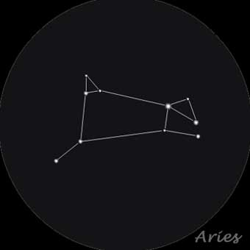
God’s Plan in the Heavens
Aries– The Ram/Alter
Aries was the golden ram that saved the life of Phrixus
Hebraic – named the month Nisan (March-April) when the Israelite slaves ere released from Egypt to follow Moses into the wilderness - 40 years later a ram’s horn brought down the walls of Jericho.
A Ram or Sheep to the Arabians, Syrians, Persians and Turks.
The Sacrifice for all (again). The final sacrifice. The high and elevated deliver.
Notes:
Was the highest constellation in the sky (now is Cancer).

Slide 29
God’s Plan in the Heavens
The final four constellations tell of:
Bring us to great judgment and the conclusion of God’s plan for a sinful world.

Slide 30
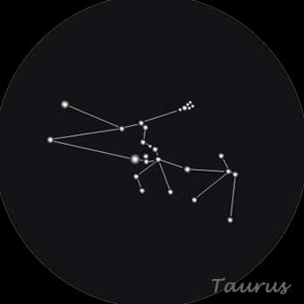
God’s Plan in the Heavens
Taurus– The Bull
Jupiter’s (Zeus)’s disguise he used to possess the fair Europa (Pasiphe).
Also associated with the Argonaut Jason that was later sacrificed to become the Golden Fleece.
Druids held their “Tauric” festival when the sun entered this constellation boundary.
Egyptians = bull god Osiris
Resurrection (Scorpius setting), Also hints at the coming of Christ since the front half of the Bull is coming out of Aries (Facing East)

Slide 31
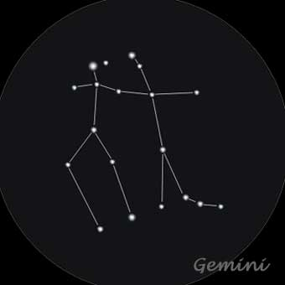
God’s Plan in the Heavens
Gemini– The Twins
Two sons of Zeus – Castor and Polydeuces (Pollux in Latin)
Twins.
Castor the Judge and Coming Ruler (The Horseman – Eques) , Pollux the strong one come to labor or rule (The Pugilist = professional fighter/boxer). Judgment by the dual nature Christ. Also interpreted as Jesus and the Church as One

Slide 32
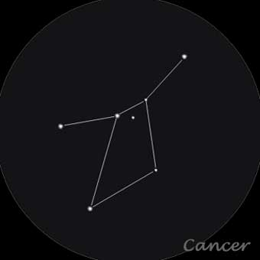
God’s Plan in the Heavens
Cancer– The Crab
A crab sent by Hera to slow down Hercules- who smashed it.
Egypt = a “Sacred” (scarabaeus – or Scarab). Emblem of immortality in the form of a beetle.
Star Cluster Praesepe “Nurturing” “The Stall” “ The crib or manger” “ The Multitude” “The Innumerable Seed” “The Israelites”
The ultimate fulfillment of the promise to Abraham- the star cluster Praesepe – the Multitude or the Innumerable Seed contained in the confines of the water born creature= the Crab – also gathering the redeemed.

Slide 33
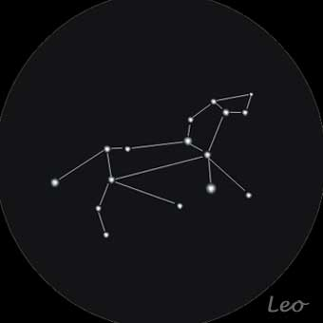
God’s Plan in the Heavens
Leo– The Lion
The first creature Hercules had to slay- a lion.
Babylonians and Egyptians saw a lion here.
The Chaldeans, 5,000 years ago, noted that summer happened when the sun was here (now in Cancer). The House of the Sun (Son).
Also seen as a goddess of agriculture and fertility by the Nabataeans.
The King, the Lion of the House of Judah. The end of the series and of time.

Slide 34
God’s Plan in the Heavens
Pisces could also be is also the origin of the Ichthys
The Greek word for fish
The Vernal Equinox entered Pisces about the time of Christ’s birth = the Age of Pisces
About now (to 400 years from now)= the Age of Aquarius
Notes:
Ages are believed by some astrologers to affect mankind while other astrologers believe the ages correlate to the rise and fall of mighty civilizations and cultural tendencies. Aquarius traditionally "rules" electricity, computers, flight, democracy, freedom, humanitarianism, idealists, modernization, astrology, nervous disorders, rebels and rebellion.^{[5]} Other keywords and ideas believed associated with Aquarius are nonconformity, philanthropy, veracity, perseverance, humanity and irresolution.^{[6]} The appearance or elevation in status of many of these Aquarian developments over the last few centuries is considered by many astrologers to indicate the proximity of the Aquarian age. There is no uniform agreement about the relationship of these recent Aquarian developments and the Age of Aquarius. Some astrologers believe that the influence of a New Age is experienced before it arrives because of a cuspal effect or Orb of Influence. Other astrologers believe the appearance of Aquarian developments, indicate the actual arrival of the Age of Aquarius. The expression Age of Aquarius in popular culture usually refers to the heyday of the hippie and New Age movements in the 1960s and 1970s. The New Age movement is more accurately a phenomenon and yet seen by many as the harbinger of this future changeover of values associated with the arrival or imminent arrival of the Aquarian age.
Although more rock than New Age in genre, the 1967 musical Hair, with its opening song "Aquarius" and the memorable line "This is the dawning of the Age of Aquarius," brought the Aquarian age concept to the attention of audiences worldwide. However, the song further defines this dawning of the age within the first lines: "When the Moon is in the seventh house, and Jupiter aligns with Mars; then peace will guide the planets, and love will steer the stars." According to Neil Spencer, the words are "astrological gibberish" as Jupiter aligns with Mars several times a year and the Moon is in the 7th House for about two hours every day.^{[27]} These lines are merely poetic license, though many people take them literally. An example is the identification of February 14, 2009 (Valentine's Day) as the "perfect alignment to support our collective manifestation of love and peace and dawning of the Age of Aquarius."
A portion of the world is ready to turn away from the Age of Christ to the Age of Man.
Age Of Aquarius lyrics When the moon is in the Seventh House And Jupiter aligns with Mars Then peace will guide the planets And love will steer the stars This is the dawning of the Age of Aquarius The Age of Aquarius Aquarius! Aquarius! Harmony and understanding Sympathy and trust abounding No more falsehoods or derisions Golden living dreams of visions Mystic crystal revelation And the mind's true liberation Aquarius! Aquarius! When the moon is in the Seventh House And Jupiter aligns with Mars Then peace will guide the planets And love will steer the stars This is the dawning of the Age of Aquarius The Age of Aquarius Aquarius! Aquarius! Let the sun shine, Let the sun shine in The sun shine in Let the sun shine, Let the sun shine in The sun shine in Let the sun shine, Let the sun shine in The sun shine in Let the sun shine, Let the sun shine in The sun shine in Let the sun shine, Let the sun shine in The sun shine in Let the sun shine, Let the sun shine in The sun shine in Let the sun shine, Let the sun shine in The sun shine in Let the sun shine, Let the sun shine in The sun shine in Let the sun shine, Let the sun shine in The sun shine in Let the sun shine, Let the sun shine in The sun shine in Let the sun shine, Let the sun shine in The sun shine in

Slide 35
God’s Plan in the Heavens
The placement of Easter in the calendar!
It is located on the first Sunday after the first full moon after the moment the Sun is on the Vernal Equinox the moment Spring begins.
(The Lunisolar calendar – similar to the Hebrew calendar)
Can occur from March 22nd to April 25th
Usually occurs about a week after Passover.

Slide 36
God’s Plan in the Heavens
If the Star of Bethlehem was not a supernatural miracle, but a miracle in creation, there is an astronomical/astrological possibility…
The Maggi (we get the word magician from them) were Zoroastrian priests – astrologers/sorcerers

Slide 37
God’s Plan in the Heavens
They would have noticed a rare triple conjunction (close pass) between the planets Jupiter (the King of planets) and Saturn (the harvester or reaper) in Pisces
The time of the harvester has come - the King of the Hebrews is arriving– at the dawn of the age of Pisces.

Slide 38
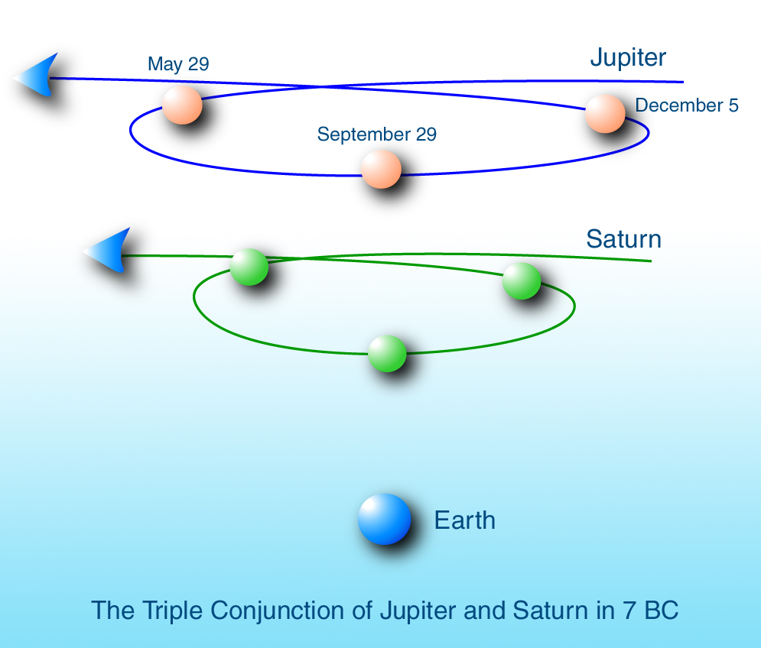
God’s Plan in the Heavens

Slide 39
God’s Plan in the Heavens
Events, interesting configurations, as well as moving bright objects in the sky (planets) were all called ‘stars.’
Rare events - on average every 456 years– other close ones:
1953 BC, 980BC, 861BC,146/145BC, 7 BC, 452 AD, 967, 1007, 1306, 1682 and 2239, 2913/4
Not in Pisces in since the Zoroastrian Religion was founded (~600BC).
Notes:
1953 BC – Aquarius, 980 BC Pisces , 861 BC Pisces , 146/145 BC Cancer, 7BC Pisces, 452 AD Libra/Virgo, 967 Aries/Pisces, 1007 Virgo, 1306 Virgo/Libra, 2239 Gemini, 2913/14 Taurus

Slide 40
God’s Plan in the Heavens
The Bible does make mention of other constellations – Orion, Taurus, the star cluster Pleiades
Job 38:31-33 (where the zodiac is described),
Psalm 147:4 (where God calls the stars by their names),
Gen 1:14-16 (the purpose of the stars is described),
Rom 1:20-23 (where he tells of foolish man where he has traded the glory and majesty of the immortal God with representations of mortal man, birds, beasts and reptiles).

Slide 41
God’s Plan in the Heavens
Even the 12 Tribes of Israel were linked to the 12 constellations of the zodiac.
The Mazzeroth
Notes:
http://ldol
It may come as a surprise to many to learn that each of the 12 tribes were associated with one of the constellations of the mazzeroth (the Hebrew zodiac.) We know these by their post-Babel names after being corrupted by pagan traditions. By learning the Hebrew names, and the names of the principal stars in the order of their magnitude, we discover they portray the entire redemptive plan of God--from the virgin birth (Virgo) to the triumph of the Lion of the Tribe of Judah (Leo).
phin.org/camp.html

Slide 42
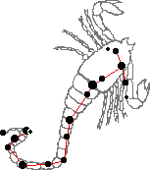
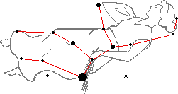
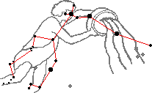
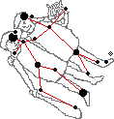
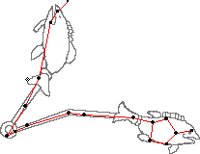
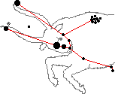
The Mazzeroth Mazzeroth (Job 38:32).
Libra
Virgo
Tribe Of Israel
Scorpio
Tribe Of Zebulon
Tribe Of Dan
Sagittarius
Tribe Of Asher
Leo
Tribe Of Judah
Capricornus
Tribe Of Naphtali
Cancer
Tribe Of Issachar
Aquarius
Tribe Of Reuben
Gemini
Tribe Of Benjamin
Pisces
Taurus
Aries
Tribe Of Simeon
Tribe Of Joseph
Tribe Of Gad

Slide 43
God’s Plan in the Heavens
And their placement around the tabernacle was linked to the signs of the zodiac.
Sill missing the explicit link…

Slide 44
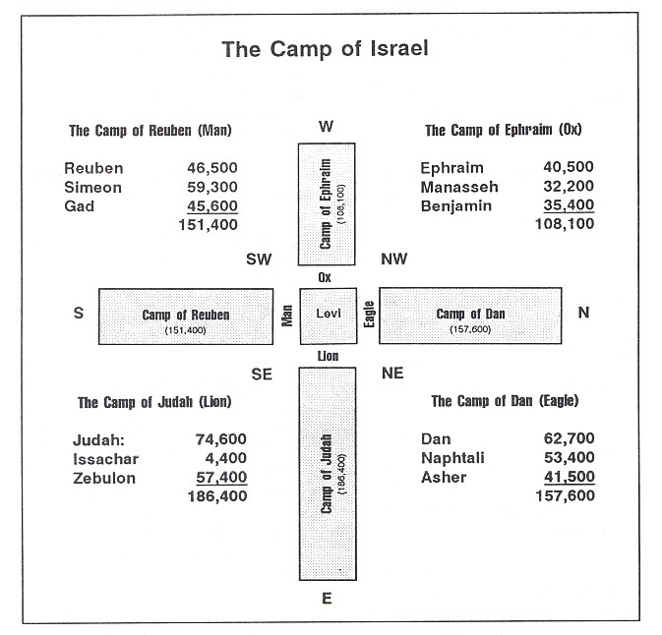
God’s Plan in the Heavens
The Cross- Shaped Placements:
Notes:
http://www.khouse.org/articles/2006/631/print/
The Camp of Israel
There is one other interesting type thats found in Numbers 2. The 12 tribes were told to group into four camps. Each tribe had a standard and symbol, but Judah, Isaachar and Zebulin were to rally around the standard of Judah. They collectively represented 186,400. Reuben, Simeon and Gad collectively represented about 151,000. Ephraim, Manasseh and Benjamin collectively represented 108,100. Dan, Asher and Naphtali, 157,600. Judahs standard was the Lion of the Tribe of Judah. Reubens was a man. Ephraims was the ox. Dan, the eagle. These four symbols are also the four faces of the cherubim around the throne of God in Isaiah 6 , Ezekiel 1 and 10, and Revelation 4.
Each of the camps, of three tribes each, was to encamp on one of the four cardinal compass directions (N, S, E, or W) with respect to the camp of the Levites enclosing the tabernacle (See here). We can only guess at how much space was required by the Levites, whether it was 100 feet on a side, 100 yards, or whatever. But whatever it was, well assume that length as a basic unit.
To fully appreciate all of the implications, you must try to think like a rabbi; you need to maintain an extremely high respect for the precise details of the instructions. They resorted to heroic measures in their attempt to comply with the letter of the law.
The Camp of Judah had to camp east of the Levites. This poses a technical problem. Notice that if the breadth of their camp was larger than that of the Levites, the excess would be southeast or northeast, not east. Therefore, if they were to comply strictly to their instructions, their camp could only be as wide as that of the Levites, and they then would have to extend eastward to obtain whatever space they required.
The camps of Reuben, Ephraim, and Dan had the same constraint on the south, west, and north, respectively. The length of each leg would thus be proportional to the total population in each camp. If we assemble what we can infer from the Biblical account, we can imagine what the camp of Israel looked like from above: the tabernacle and the Levites in the center, surrounded by the four faces of the tribal standards, and each of the four camps of Judah, Ephraim, Reuben, and Dan, stretching out in the four cardinal directions. We can also tally the size of each tribe to total the relative length of each camp as they stretched out in each of the four directions. (See the plan view, on a relative scale, here).
The Book of Numbers is a fascinating study in many ways. Expositionally, it demonstrates integrity of Design; homiletically, it reveals that these were real people with practical problems; and, devotionally, we see that ''crossing over Jordon'' is not ''going to Heaven'' - life is a warfare. Each one of us is in our own ''wilderness'' and every day is our ''Kadesh-Barnea'' - will we trust God and ''conquer the land''? Will we resolutely try to surmount the obstacles that lie in our wayor will we shrink from the apparent difficulties and remain slaves to the sin in our lives?

Slide 45
God’s Plan in the Heavens
So is astrology good for telling you future?
Are the Heavenly bodies something to worship?
Tower of Babel –Gen 11:4b Come, let us build ourselves a city, with a tower that reaches to the heavens,
A tower unto the Heavens – could be to reach it or to worship it (dedicated to it)?
Bad news.
Notes:
So is astrology good for telling you future? No, I'd say not.
Are the Heavenly bodies something to worship? No way.
Are they essential in telling of the gospel? Not any more. We have the Bible now; the revealed word of God in our hands in multiple translations and versions. The skies might have been the way God made all men without excuse when it came to knowing him. Now He is present on the Earth in his Church and His active Spirit.
This exploration of astrology was an attempt to peel back a layer of deceit - the possibility that the hunger to know the future from the stars is a left over of the desire to see the coming savior from them.
To really ‘get’ it, you would need the Author, the Spirit of Christ instructing as you beheld it, just like you need the Author working on and in you to bring the Bible itself to life.

Slide 46
God’s Plan in the Heavens
Are they essential in telling of the gospel?
The skies might have been the way God made all men without excuse when it came to knowing him.
Romans 1:20 For since the creation of the world God’s invisible qualities—his eternal power and divine nature—have been clearly seen, being understood from what has been made, so that people are without excuse.
Notes:
So is astrology good for telling you future? No, I'd say not.
Are the Heavenly bodies something to worship? No way.
Are they essential in telling of the gospel? Not any more. We have the Bible now; the revealed word of God in our hands in multiple translations and versions. The skies might have been the way God made all men without excuse when it came to knowing him. Now He is present on the Earth in his Church and His active Spirit.
This exploration of astrology was an attempt to peel back a layer of deceit - the possibility that the hunger to know the future from the stars is a left over of the desire to see the coming savior from them.
To really ‘get’ it, you would need the Author, the Spirit of Christ instructing as you beheld it, just like you need the Author working on and in you to bring the Bible itself to life.

Slide 47
God’s Plan in the Heavens
This exploration of astrology was an attempt to peel back a layer of deceit - the possibility that the hunger to know the future from the stars is a left over of the desire to see the coming savior from them.
To really ‘get’ it, you would need the Author, the Spirit of Christ instructing as you beheld it, just like you need the Author working on and in you to bring the Bible, His Word, to life.
Notes:
So is astrology good for telling you future? No, I'd say not.
Are the Heavenly bodies something to worship? No way.
Are they essential in telling of the gospel? Not any more. We have the Bible now; the revealed word of God in our hands in multiple translations and versions. The skies might have been the way God made all men without excuse when it came to knowing him. Now He is present on the Earth in his Church and His active Spirit.
This exploration of astrology was an attempt to peel back a layer of deceit - the possibility that the hunger to know the future from the stars is a left over of the desire to see the coming savior from them.
To really ‘get’ it, you would need the Author, the Spirit of Christ instructing as you beheld it, just like you need the Author working on and in you to bring the Bible itself to life.

